Slide 1
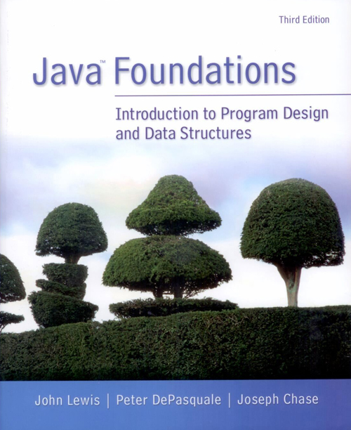
Chapter 2
Data and Expressions

Slide 2
Objectives
Problem solving is about how to identify/deal with data to solve a given problem.
How to store data
How to process data
What kind of data types?
Discuss the use of character strings, concatenation, and escape sequences
Explore the declaration and use of variables
Describe the Java primitive data types
Discuss the syntax and processing of expressions
Define the types of data conversions and the mechanisms for accomplishing them
Introduce the Scanner class to create interactive programs

Slide 3
Content
Character strings
Variables and assignment
Primitive data types
Expressions
Data conversion
Reading input data

Slide 4
1. Character Strings
Programs usually process data.
[Q] What kind of data can we use? Where to store? How to process them?
[Q] Can you see data in the following program?
public class Lincoln
{
public static void main(String[] args)
{
System.out.println("A quote by Abraham Lincoln:");
System.out.println("Whatever you are, be a good one.");
}
}
When methods are used, data may be passed to them like this example of .println().
Notes:
A String literal is a sequence of characters used by Java programmers to populate String objects or display text to a user.
Literal: A letter or symbol that stands for itself as opposed to a feature, function, or entity associated with it in a programming language: ‌$ can be a symbol that refers to the end of a line, but as a literal, it is a dollar sign.

Slide 5
1. Character Strings
A string of characters can be represented as a string literal by putting double quotes around it.
Examples:
"This is a string literal."
"123 Main Street"
"X"
"&_23d", ...
Every character string is an object in Java, defined by the String class.
Every string literal represents a String object.
We will discuss about objects and classes again and again through out the course.
[Q] How do you print values, e.g., strings?
Notes:
A String literal is a sequence of characters used by Java programmers to populate String objects or display text to a user.
Literal: A letter or symbol that stands for itself as opposed to a feature, function, or entity associated with it in a programming language: ‌$ can be a symbol that refers to the end of a line, but as a literal, it is a dollar sign.

Slide 6
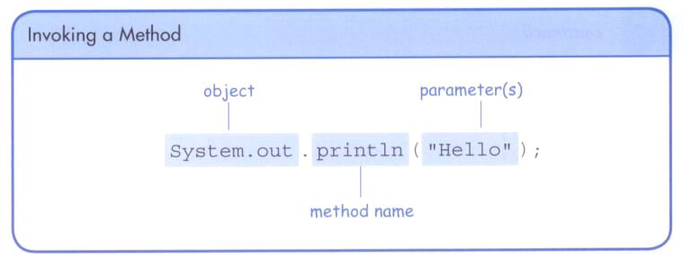
1.1 The println() Method
In the Lincoln program, we invoked the println() method to print a character string.
[Q] How do you know whether an identifier is a method or not?
E.g., println(...);
The System.out object represents a destination (the monitor) to which we can send output.
[Q] What is ‘.’ between System.out and println()?
Notes:
Invoke: summon into action or bring into existence, often as if by magic

Slide 7
The print() Method
The System.out object provides another service as well.
The print() method is similar to the println() method, except that it does not advance to the next line.
Therefore, anything printed after a print() statement will appear on the same line.

Slide 8
//********************************************************************
// Countdown.java Java Foundations
//
// Demonstrates the difference between print and println.
//********************************************************************
public class Countdown
{
//-----------------------------------------------------------------
// Prints two lines of output representing a rocket countdown.
//-----------------------------------------------------------------
public static void main(String[] args)
{
System.out.print("Three... ");
System.out.print("Two... ");
System.out.print("One... ");
System.out.print("Zero... ");
System.out.println("Liftoff!"); // appears on first output line
System.out.println("Houston, we have a problem.");
}
}
[Q] What results?
Three... Two... One... Zero... Liftoff!
Houston, we have a problem.

Slide 9
[X] Let’s try to write Woderful.java that prints
"What an interesting "
"course, COMP 1130-04!"
You need to use two print() or println() methods. But the above strings should be displayed in the same line.

Slide 10
[Q] How about
System. out . println("Correct or wrong?");
[Q] For what do we use white spaces?
[Q] Do we always need to use white spaces?

Slide 11
Intermediate Summary
In the previous slides, we discussed character strings, one type of data.
[Q] How to manipulate them?
print(), println()
[X] Let’s try to write a Java program to print "What a wonderful world!".
[Q] Any operations with string values?
Notes:
Concatenate: combine two strings to form a single one

Slide 12
1.2 String Concatenation
The string concatenation operator (+) is used to append one string to the end of another.
"Peanut butter " + "and jelly"
[Q] The result of the above operation is?
It can also be used to append a number to a string.
"Dialing code for Antarctica: " + 672
40 + "km over"
[Q] The results of the above operations are?
A string literal can NOT be broken across two lines in a program. Then what do you have to do?
"This is not
right."
[Q] Then?
[Q] Can you see a different data type in the above examples?
Notes:
Concatenate: combine two strings to form a single one

Slide 13
//********************************************************************
// Facts.java Java Foundations
//
// Demonstrates the use of the string concatenation operator and the
// automatic conversion of an integer to a string.
//********************************************************************
public class Facts
{
// Prints various facts.
public static void main(String[] args)
{
// Strings can be concatenated into one long string
System.out.println("We present the following facts for your "
+ "extracurricular edification:");
System.out.println();
// A string can contain numeric digits
System.out.println("Letters in the Hawaiian alphabet: 12");
// A numeric value can be concatenated to a string
System.out.println("Dialing code for Antarctica: " + 672);
System.out.println("Year in which Leonardo da Vinci invented "
+ "the parachute: " + 1515);
System.out.println("Speed of ketchup: " + 40 + "km per year");
System.out.println(40 + "km over"); // ???
}
}
[Q] What results?

Slide 14
The + operator is also used for arithmetic addition.
The function that it performs depends on the type of the information on which it operates.
If both operands are strings, or if one is a string and one is a number, it performs string concatenation.
If both operands are numeric, it adds them.
The + operator is evaluated left to right, but parentheses can be used to force the order.

Slide 15
//********************************************************************
// Addition.java Java Foundations
//
// Demonstrates the difference between the addition and string
// concatenation operators.
//********************************************************************
public class Addition
{
//-----------------------------------------------------------------
// Concatenates and adds two numbers and prints the results.
//-----------------------------------------------------------------
public static void main(String[] args)
{
System.out.println("24 and 45 concatenated: " + 24 + 45);
System.out.println(("24 and 45 concatenated: " + 24) + 45);
System.out.println("24 and 45 added: " + (24 + 45));
}
}
[Q] What results?
[X] Let’s try this program with Geany.

Slide 16
Intermediate Summary
Operator, ‘+’
String concatenation
Arithmetic addition
[X] Let’s try to write a Java program that prints the summation of three integer values 1234, 2345, and 3456.
Notes:
Concatenate: combine two strings to form a single one

Slide 17
1.3 Escape Sequences
[Q] What if we wanted to print a the quote character?
The following line would confuse the compiler because it would interpret the second quote as the end of the string. [Q] What will happen?
System.out.println("I said "Hello" to you.");
System.out.println("I said " Hello " to you.");
An escape sequence is a series of characters that represents a special character.
An escape sequence begins with a backslash character (\).
System.out.println("I said \"Hello\" to you.");

Slide 18
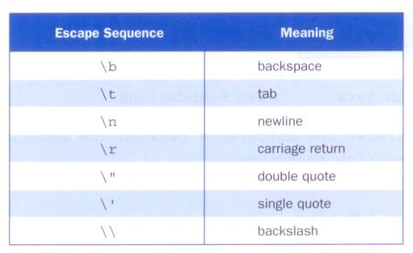
Some Java escape sequences:
Notes:
public class testBeep {
public static main(String args[]) {
// ASCII bell
System.out.print("\007");
System.out.flush();
}
}

Slide 19
//********************************************************************
// Roses.java Java Foundations
//
// Demonstrates the use of escape sequences.
//********************************************************************
public class Roses
{
//-----------------------------------------------------------------
// Prints a poem (of sorts) on multiple lines.
//-----------------------------------------------------------------
public static void main(String[] args)
{
System.out.println("Roses are red,\n\tViolets are blue,\n" +
"Sugar is sweet,\n\tBut I have \"commitment issues\",\n\t" +
"So I'd rather just be friends\n\tAt this point in our " +
"relationship.");
}
}
[Q] What results?
[X] Let’s try with Geany.

Slide 20
Intermediate Summary
[Q] How many different kinds of data so far?
Strings, integers
[Q] How many different operators so far?
String concatenation: +
Integer addition: +
Notes:
Concatenate: combine two strings to form a single one

Slide 21
Content
Character strings
Variables and assignment
Primitive data types
Expressions
Data conversion
Reading input data

Slide 22
2. Variables and Assignment
We have discussed so far how to deal with strings in the previous section.
[Q] Now, how can we store data in main memory, so that we can deal with them in the program?
[Q] For example, how to read 100 values and find the average? We need to know how to save those values somewhere in the program.
Notes:
public class testBeep {
public static main(String args[]) {
// ASCII bell
System.out.print("\007");
System.out.flush();
}
}

Slide 23
2.1 Variables
A variable is a name for a location in memory. It is used to store a value. It is a data storage.
A variable must be declared by specifying its name and the type of information that it will hold.
data type
variable name
int total;
int count, temp, result;
Multiple variables of the same type can be created in one declaration.

Slide 24
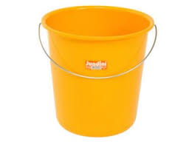
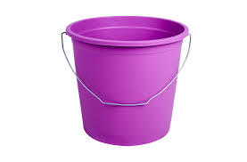
Variables are like buckets.
[Q] How to store data into variables?

Slide 25
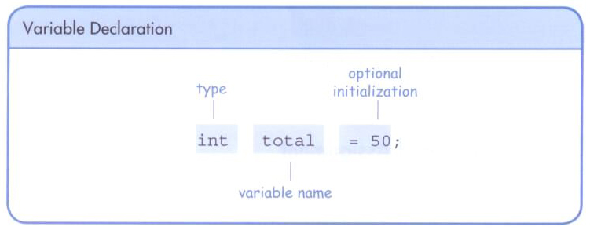
A variable can be given an initial value in the declaration.
When a variable is used in a program, its current value is used.
Assignment operator

Slide 26
//********************************************************************
// PianoKeys.java Java Foundations
//
// Demonstrates the declaration, initialization, and use of an
// integer variable.
//********************************************************************
public class PianoKeys
{
//-----------------------------------------------------------------
// Prints the number of keys on a piano.
//-----------------------------------------------------------------
public static void main(String[] args)
{
int numberOfKeys = 88;
System.out.println("A piano has " + numberOfKeys + " keys.");
}
}
[Q] What results?
Variables must be declared before they are used.

Slide 27
//********************************************************************
// PianoKeys.java Java Foundations
//
// Demonstrates the declaration, initialization, and use of an
// integer variable.
//********************************************************************
public class PianoKeys
{
//-----------------------------------------------------------------
// Prints the number of keys on a piano.
//-----------------------------------------------------------------
public static void main(String[] args)
{
numberOfKeys = 88;
System.out.println("A piano has " + numberOfKeys + " keys.");
}
}
[Q] What about this?
[X] Let’s try.
Noooooo good!
Variables must be declared before they are used.

Slide 28
//********************************************************************
// PianoKeys.java Java Foundations
//
// Demonstrates the declaration, initialization, and use of an
// integer variable.
//********************************************************************
public class PianoKeys
{
//-----------------------------------------------------------------
// Prints the number of keys on a piano.
//-----------------------------------------------------------------
public static void main(String[] args)
{
System.out.println("A piano has " + keys + " keys.");
int keys = 88;
}
}
[Q] What about this?
[X] Let’s try.
No good!
Variables must be declared before they are used.

Slide 29
2.2 Assignment Operator
[Q] How to save values in variables?

Slide 30
An assignment statement changes the value of a variable.
The assignment operator is the = sign.
The expression on the right is evaluated and the result is stored in the variable on the left.
The value that was in total is overwritten.
You can only assign a value to a variable that is consistent with the variable's declared type.
[Q] Can you assign a string into an int variable? int total = "Is it okay?";
int total;
total = 55;

Slide 31
//********************************************************************
// Geometry.java Java Foundations
//
// Demonstrates the use of an assignment statement to change the
// value stored in a variable.
//********************************************************************
public class Geometry
{
//-----------------------------------------------------------------
// Prints the number of sides of several geometric shapes.
//-----------------------------------------------------------------
public static void main(String[] args)
{
int sides = 7; // declaration with initialization
System.out.println("A heptagon has " + sides + " sides.");
sides = 10; // assignment statement
System.out.println("A decagon has " + sides + " sides.");
sides = sides + 12;
System.out.println("A dodecagon has " + sides + " sides.");
}
}
[Q] What results?

Slide 32
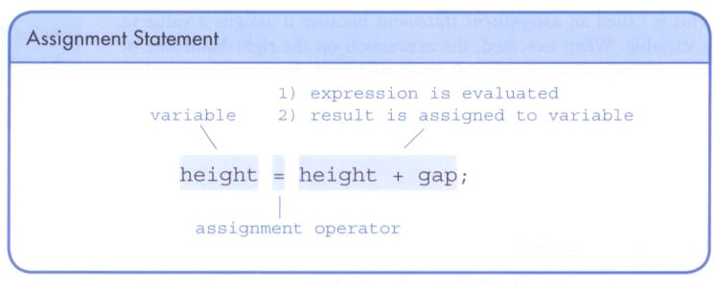
The right-hand side could be an expression.
The expression is completely evaluated, and the result is stored in the variable.

Slide 33
Intermediate Summary
Data types
String
int
Expression and operators
+, =, (), .
Statement
Assignment statement
[Q] How many operators have we discussed so far?
[X] Let’s write a Java program that assigns two numbers 10 and 20 into two separate variables, adds them, saves the result into another variable, and prints the result.

Slide 34
2.3 Constants
A constant is an identifier that is similar to a variable except that it holds the same value during its entire existence.
As the name implies, it is constant, not variable.
The compiler will issue an error if you try to change the value of a constant.
In Java, we use the final modifier to declare a constant, always with an initial value.
final int MIN_HEIGHT = 69; // Correct dec...
MIN_HEIGHT = 120; // [Q] Good?

Slide 35
Constants are useful for three important reasons.
First, they give meaning to otherwise unclear literal values.
For example, MAX_LOAD means more than the literal 250.
Second, they facilitate program maintenance.
If a constant is used in multiple places, its value need only be updated in one place.
Constants are usually declared early.
Third, they formally establish that a value should not change, avoiding inadvertent errors by other programmers.
Usually upper case letters with ‘_’: MIN_HEIGHT

Slide 36
Content
Character strings
Variables and assignment
Primitive data types
Expressions
Data conversion
Reading input data

Slide 37
3. Primitive Data Types
There are eight primitive data types in Java.
Four of them represent integers
byte, short, int, long
Two of them represent floating point numbers (what ???)
float, double
One of them represents characters
char
And one of them represents boolean values
boolean
[Q] Examples of boolean type values?
Let’s always use int and double for numbers in this course.

Slide 38
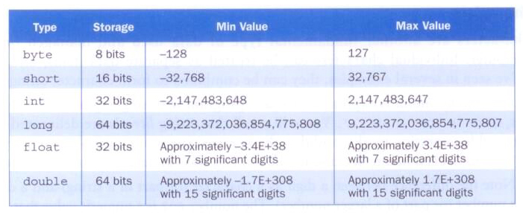
3.1 Numeric Types
The difference between the various numeric primitive types is their size, and therefore the values they can store:

Slide 39
3.2 Characters
A char variable stores a single character.
Character literals are delimited by single quotes:
'a' 'X' '7' '$' ',' '\n' '\''
[Q] How about "a" and "X"?
Example declarations
char topGrade = 'A';
char terminator = ';', separator = ' ';
Note the distinction between a primitive character variable, which holds only one character, and a String object, which can hold multiple characters.
[Q] How about the following? Anything wrong? char c1 = ''; // no space
char c2 = ' '; // two spaces
No good!

Slide 40
Character Sets
A character set is an ordered list of characters, with each character corresponding to a unique number.
A char variable in Java can store any character from the Unicode character set.
The Unicode character set uses sixteen bits per character. ([Q] How many bytes are 16 bits?)
It is an international character set, containing symbols and characters from many world languages.

Slide 41
Characters
The ASCII character set is older and smaller than Unicode.
The ASCII characters are a subset of the Unicode character set, including:
uppercase letters
lowercase letters
punctuation
digits
special symbols
control characters
A, B, C, …
a, b, c, …
period, semi-colon, …
0, 1, 2, …
&, |, \, …
carriage return, tab, ...
Notes:
ASCII stands for American Standard Code for Information Interchange. Computers can only understand numbers, so an ASCII code is the numerical representation of a character such as 'a' or '@' or an action of some sort.

Slide 42
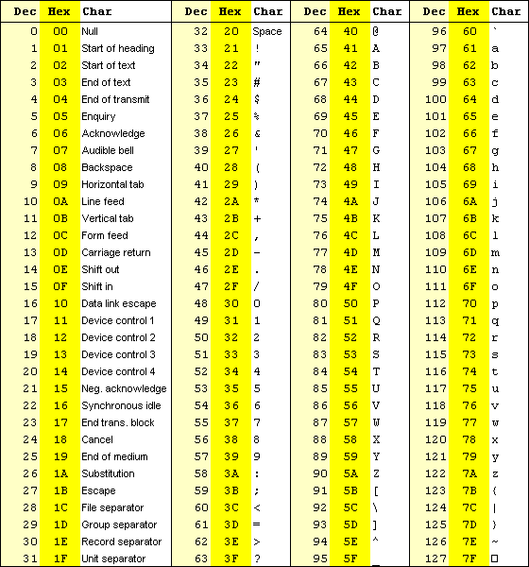

Slide 43
3.3 Booleans
A boolean value represents a true or false condition.
The reserved words true and false are the only valid values for a boolean type. [Q] Are they strings?
boolean done = false;
boolean done = "false"; // [Q] ???
A boolean variable can also be used to represent any two states, such as a light bulb being on or off.

Slide 44
Intermediate Summary
List all the data types with their corresponding Java identifiers and example values.
Notes:
ASCII stands for American Standard Code for Information Interchange. Computers can only understand numbers, so an ASCII code is the numerical representation of a character such as 'a' or '@' or an action of some sort.

Slide 45
Content
Character strings
Variables and assignment
Primitive data types
Expressions
Data conversion
Reading input data

Slide 46
4. Expressions
An expression is a combination of one or more operators and operands.

Slide 47
4.1 Arithmetic Operators
Arithmetic expressions compute numeric results and make use of the arithmetic operators.
Addition +
Subtraction -
Multiplication *
Division /
Remainder %
double kilometers = 1.6 miles; // No good
double kilometers = 1.6 * miles; // Good; [Q] What is miles?
If either or both operands used by an arithmetic operator are floating point, then the result is a floating point.

Slide 48
Division and Remainder
If both operands to the division operator (/) are integers, the result is an integer (the fractional part is discarded).
The remainder operator (%) returns the remainder after dividing the second operand into the first. Usually, this operator is used for non-negative integers.
14 / 3 equals
4, not 4.6666…
8 / 12 equals
0, not 0.6…
8.5 / 10 equals
0.85, not 0
14 % 3 equals
2
8 % 12 equals
8.5 % 12 equals
8
8.5

Slide 49
4.2 Operator Precedence
Operators can be combined into complex expressions. [Q] What is the result of the following code?
int result, total = 300, count = 5,
max = 100, offset = 10;
result = total + count / max - offset;
Operators have a well-defined precedence which determines the order in which they are evaluated.
Multiplication, division, and remainder are evaluated prior to addition, subtraction, and string concatenation.
Arithmetic operators with the same precedence are evaluated from left to right, but parentheses can be used to force the evaluation order.
Notes:
Precedence: status established in order of importance or urgency; preceding in time; the act of preceding in time or order or rank (as in a ceremony)

Slide 50
[Q] What is the order of evaluation in the following expressions? The results?
int a = 1, b = 2, c = 3, d = -4, e = 2;
a + b + c + d + e
a + b * c - d / e
a / (b + c) - d % e
a / (b * (c + (d - e)))

Slide 51
[Q] What is the order of evaluation in the following expressions? The results?
int a = 1, b = 2, c = 3, d = -4, e = 2;
a + b + c + d + e
a + b * c - d / e
1
2
3
4
3
1
4
2
a / (b + c) - d % e
2
1
4
3
a / (b * (c + (d - e)))
4
3
2
1
Notes:
a = 16
b = 2
c = 2
d = 5
e = 3
28
19
2
2

Slide 52
Precedence among some Java operators:

Slide 53
//********************************************************************
// TempConverter.java Java Foundations
//
// Demonstrates the use of primitive data types and arithmetic
// expressions.
//********************************************************************
public class TempConverter
{
//-----------------------------------------------------------------
// Computes the Fahrenheit equivalent of a specific Celsius
// value using the formula F = (9/5)C + 32.
//-----------------------------------------------------------------
public static void main (String[] args)
{
final int BASE = 32;
final double CONVERSION_FACTOR = 9.0 / 5.0;
double fahrenheitTemp;
int celsiusTemp = 24; // value to convert
fahrenheitTemp = celsiusTemp * CONVERSION_FACTOR + BASE;
System.out.println ("Celsius Temperature: " + celsiusTemp);
System.out.println ("Fahrenheit Equivalent: " + fahrenheitTemp);
}
}
[Q] What results?

Slide 54
Assignment Revisited
The assignment operator has a lower precedence than the arithmetic operators.
First the expression on the right hand
side of the = operator is evaluated.
answer = sum / 4 + MAX * lowest;
4
1
3
2
Then the result is stored in the
variable on the left hand side.

Slide 55
The right and left hand sides of an assignment statement can contain the same variable.
First, one is added to the
original value of count.
count = count + 1;
Then the result is stored back into count
(overwriting the original value).

Slide 56
4.3 Increment and Decrement Operators
The increment and decrement operators use only one operand.
The increment operator (++) adds one to its operand.
The decrement operator (--) subtracts one from its operand.
The statement
count++;
is functionally equivalent to
count = count + 1;

Slide 57
The increment and decrement operators can be applied in postfix form
int tmp, count = 0; tmp = count++; count++;
or prefix form
int tmp, count = 0; tmp = --count; --count;
When used as part of a larger expression, the two forms can have different effects.
Because of their subtleties, the increment and decrement operators SHOULD be used with care.

Slide 58
4.4 Assignment Operators
Often we perform an operation on a variable, and then store the result back into that variable.
Java provides assignment operators to simplify that process.
For example, the statement
num += count;
is equivalent to
num = num + count;

Slide 59
There are many assignment operators in Java, including the following:
Operator
+=
-=
*=
/=
%=
Example
x += y
x -= y
x *= y
x /= y
x %= y
Equivalent To
x = x + y
x = x - y
x = x * y
x = x / y
x = x % y

Slide 60
The right hand side of an assignment operator can be a complex expression.
The entire right-hand expression is evaluated first, then the result is combined with the original variable.
Therefore
result /= (total-MIN) % num;
is equivalent to
result = result / ((total-MIN) % num);

Slide 61
The behavior of some assignment operators depends on the types of the operands.
If the operands to the += operator are strings, the assignment operator performs string concatenation.
The behavior of an assignment operator (+=) is always consistent with the behavior of the corresponding operator (+).

Slide 62
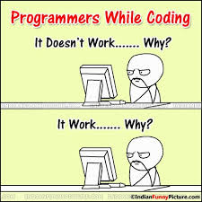
Notes:
http://www.pinterest.com/anitaborg/famous-women-in-computer-science/
http://en.wikipedia.org/wiki/Marissa_Mayer

Slide 63
Example
You have 5 quarters, 2 dimes, 12 nickels, and 20 pennies in a jar.
Determine the total value of the coins in cents
E.g., 5 quarters, 2 dimes, 12 nickels, and 20 cents => 5 * 25 + 2 * 10 + 12 * 5 + 20 * 1 = 170 cents
int q = 5, d = 2, n = 12, c = 20;
int total;
total = ???
Determine the total in dollars and cents
E.g., 170 cents => 1 dollars and 70 cents
int dollars, cents;
dollars = ???
cents = ???
Notes:
ASCII stands for American Standard Code for Information Interchange. Computers can only understand numbers, so an ASCII code is the numerical representation of a character such as 'a' or '@' or an action of some sort.

Slide 64
Example
You have 5 quarters, 2 dimes, 12 nickels, and 20 pennies in a jar.
Determine the total value of the coins in cents
E.g., 5 quarters, 2 dimes, 12 nickels, and 20 pennies => 5 * 25 + 2 * 10 + 12 * 5 + 20 * 1 = 170 cents
int q = 5, d = 2, n = 12, p = 20;
int total;
total = 25 * q + 10 * d + 5 * n + 1 * p;
Determine the total in dollars and cents
E.g., 170 cents => 1 dollars and 70 cents
int dollars, cents;
dollars = total / 100;
cents = total % 100;
Notes:
ASCII stands for American Standard Code for Information Interchange. Computers can only understand numbers, so an ASCII code is the numerical representation of a character such as 'a' or '@' or an action of some sort.

Slide 65
Content
Character strings
Variables and assignment
Primitive data types
Expressions
Data conversion
Reading input data

Slide 66
5. Data Conversions
Sometimes it is convenient to convert data from one type to another, especially integers and floating point values.
For example, in a particular situation we may want to treat an integer as a floating point value.
These conversions do not change the type of a variable or the value that's stored in it – they only convert a value as part of a computation.

Slide 67
A simple rule about the data conversions – Can Hulk go through the small door?
No, he can’t. Why?
He is bigger than the door.

Slide 68
From bigger data types to smaller data types:
long > int > short > byte
int larger; short smaller;
smaller = 20; larger = smaller;
double > float
double larger; float smaller;
smaller = 20; larger = smaller;
double > float > long > int > short > byte
From smaller data types to bigger data types:
In general it is NOT good.
int larger; short smaller; larger = 20; smaller = larger;
double larger; float smaller; larger = 20.5; smaller = larger;
Note that floating point values are considered bigger than integer values.
float y; int x; x = 34; y = x;
Note the integer values are considered as int, and floating point values as double, not float.
int count = 10; double sum = 34.5;
float anotherSum = 45.6; // ?

Slide 69
Conversions must be handled carefully to avoid losing information.
Widening conversions are safest because they tend to go from a small data type to a larger one (such as a short to an int).
Narrowing conversions can lose information because they tend to go from a large data type to a smaller one.
In Java, data conversions can occur in three ways
assignment conversion
promotion
casting

Slide 70
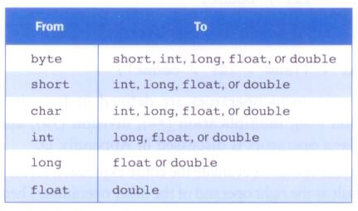
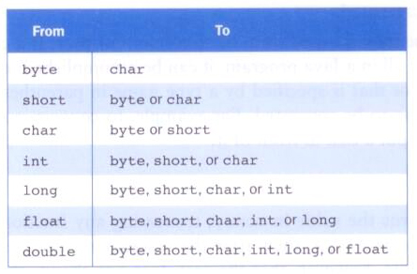
Widening Conversions
Narrowing Conversions
Notes:
char: a 16-bit unsigned integer

Slide 71
Assignment Conversion
Assignment conversion occurs when a value of one type is assigned to a variable of another.
If money is a float variable and dollars is an int variable, the following assignment converts the value in dollars to a float.
money = dollars;
Only widening conversions can happen via assignment.
Note that the value or type of dollars did not change.
Note that floating point values are considered bigger than integer values.

Slide 72
Promotion
Promotion happens automatically when operators in expressions convert their operands.
For example, if sum is a float and count is an int, the value of count is converted to a floating point value to perform the following calculation.
result = sum / count;

Slide 73
Casting
Casting is the most powerful, and dangerous, technique for conversion.
Both widening and narrowing conversions can be accomplished by explicitly casting a value.
To cast, the type is put in parentheses in front of the value being converted.
For example, if total and count are integers, but we want a floating point result when dividing them, we can cast total.
result = (float) total / count;
result = ((float) total) / count;

Slide 74
Content
Character strings
Variables and assignment
Primitive data types
Expressions
Data conversion
Reading input data

Slide 75
6. Reading Input Data
Data can be submitted to a running program, and the program can process the data.
[Q] How do Java programs read data from the user?

Slide 76
The Scanner Class
The Scanner class provides convenient methods for reading input values of various types.
A Scanner object can be set up to read input from various sources, including the user typing values on the keyboard.
Keyboard input is represented by the System.in object.

Slide 77
Reading Input
The following line creates a Scanner object that reads from the keyboard.
Scanner scan = new Scanner(System.in);
The new operator creates the Scanner object.
Once created, the Scanner object can be used to invoke various input methods, such as
answer = scan.nextLine();

Slide 78
The Scanner class is part of the java.util class library, and must be imported into a program to be used.
The nextLine() method reads all of input until the end of the line is found.
We'll discuss the details of object creation and class libraries later.

Slide 79
nextLine()
The Scanner class method nextLine() reads a string up to "\n".
next(), nextInt(), nextDouble(), etc. do not consume the last newline character ("\n"). Thus that newline is consumed in the next call to nextLine().
After calling next(), nextInt(), nextDouble(), etc, it is necessary to have an additional nextLine() to consume the previous newline before calling nextLine() to read a string.

Slide 80
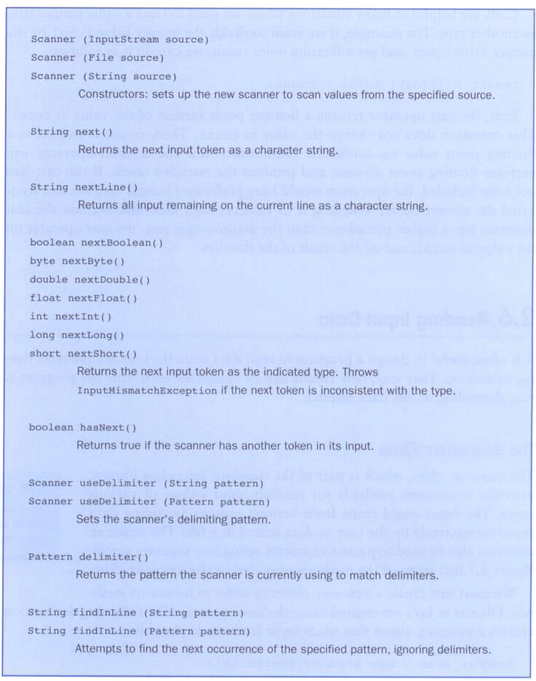
xxx
Some methods of the Scanner class:

Slide 81
//********************************************************************
// Echo.java Java Foundations
//
// Demonstrates the use of the nextLine method of the Scanner class
// to read a string from the user.
//********************************************************************
import java.util.Scanner;
public class Echo
{
//-----------------------------------------------------------------
// Reads a character string from the user and prints it.
//-----------------------------------------------------------------
public static void main(String[] args)
{
String message;
Scanner scan = new Scanner(System.in);
System.out.println("Enter a line of text:");
message = scan.nextLine();
System.out.println("You entered: \"" + message + "\"");
}
}
[X] Let’s try this program.

Slide 82
Input Tokens
Unless specified otherwise, white space is used to separate the elements (called tokens) of the input.
White space includes space characters, tabs, new line characters.
The next() method of the Scanner class reads the next input token and returns it as a string.
Methods such as nextInt() and nextDouble() read data of particular types.
Notes:
Token: an individual instance of a type of symbol

Slide 83
import java.util.Scanner;
public class GasMileage
{
public static void main(String[] args)
{
int miles;
double gallons, mpg;
Scanner scan = new Scanner(System.in);
System.out.print("Enter the number of miles: ");
miles = scan.nextInt();
System.out.print("Enter the gallons of fuel used: ");
gallons = scan.nextDouble();
mpg = miles / gallons;
System.out.println("Miles Per Gallon: " + mpg);
}
}
[X] Let’s try this program.

Slide 84
[X] Let’s try to write a Java program that reads 5 integer values and prints the average.
Notes:
Token: an individual instance of a type of symbol

Slide 85
Using nextLine() and next()
After reading all the input until the end of the line from the keyboard (which might contain multiple words delimited by spaces), you can get each token from that input using another Scanner object and next() method.
Scanner scan1 = new Scanner(System.in);
String input = scan1.nextLine();
Scanner scan2 = new Scanner(input);
String token1 = scan2.next();
String token2 = scan2.next();
scan1 and scan2 are different Scanner objects.

Slide 86
import java.util.Scanner;
public class TokenTest
{
public static void main(String[] args)
{
String input, token1, token2, token3;
Scanner scan1, scan2;
scan1 = new Scanner(System.in);
System.out.print("Enter at least three words: ");
input = scan1.nextLine();
scan2 = new Scanner(input);
token1 = scan2.next();
token2 = scan2.next();
token3 = scan2.next();
System.out.println("Your first word: " + token1);
System.out.println("Your second word: " + token2);
System.out.println("Your third word: " + token3);
}
}

Slide 87
Review
Some common errors
Class names should be the same as the Java source file names.
Class definition, and main method in the class.
printin() instead of println()
[Q] How to print multiple values in the same line?
int first = 10, second = 20, third = 30;
System.out.println(first, second, third); // No good, then?
Use the class name as a variable
public class Test
{
public static void main(String[] args) {
int Test; // No good
...
}
}

Slide 88
[Q] How to read values from the user
import java.util.Scanner; before the class definition
import java.util.Scanner;
public class Test {
...
}
Data conversions
float factor = 1.6; // Note that floating point values are
// considered as double type.
Integer division

Slide 89
import java.util.Scanner;
public class Review1
{
public static void main(String[] args);
{
int quarters, dimes, nickels, pennies;
float factor = 1.6, cents;
double miles, kilometers, dollars;
Scanner scan = new Scanner(System.in);
quarters = scan.nextInt(); // What if the user enters 34.5?
dimes = scan.nextInt();
pennies = scan.nextInt();
miles = scan.nextDouble();
kilometers = 1.6 * miles;
System.out.printin("The three values are ", quarters, dimes, pennies);
System.out.printin(miles + " miles = " + kilometers + " kilometers");
cents = quarters * 25 + dimes * 10 + nickels * 5 + pennies;
dollars = cents / 100;
cents %= 100;
System.out.println(dollars + " dollars and " + cents + " cents");
}
}
Find errors!

Slide 90
Example
Read integer values that represent the number of quarters, dimes, nickels, and pennies.
Determine the total value of the coins in cents
E.g., 5 quarters, 2 dimes, 12 nickels, and 20 cents => 5 * 25 + 2 * 10 + 12 * 5 + 20 * 1 = 170 cents
Determine the total in dollars and cents
E.g., 245 cents => 2 dollars and 45 cents
total = 245;
Dollars = total / 100;
Cents = total % 100;
Notes:
ASCII stands for American Standard Code for Information Interchange. Computers can only understand numbers, so an ASCII code is the numerical representation of a character such as 'a' or '@' or an action of some sort.

Slide 91
Example
Read integer values that represent the number of quarters, dimes, nickels, and pennies.
Determine the total value of the coins in cents
E.g., 5 quarters, 2 dimes, 12 nickels, and 20 pennies => 5 * 25 + 2 * 10 + 12 * 5 + 20 * 1 = 170 cents
int q, d, n, p, total;
q = scan.nextInt(); ...
total = ...
Determine the total in dollars and cents
E.g., 170 cents => 1 dollars and 70 cents
int dollars, cents;
dollars = total / 100;
cents = ...
Notes:
ASCII stands for American Standard Code for Information Interchange. Computers can only understand numbers, so an ASCII code is the numerical representation of a character such as 'a' or '@' or an action of some sort.

Slide 92
Review Questions

